Slide 1
Mathematics 2 (15B11MA211)
CO [C106.6]
Topic: Evaluation of Real Integrals Using Residues
Reference for the lecture
R.K Jain and S.R.K. Iyenger, “Advanced Engineering Mathematics” fifth edition, Narosa publishing house, 2016.
E. Kreyszig "Advanced Engineering Mathematics” 8th Edition, Wiley. 2006.
B. S. Grewal , “Higher Engineering Mathematics” 42 nd
Edition, Khanna Publisher, New Delhi

Slide 2
Topics to be covered
Real definite integrals involving trigonometric functions
Solved Examples

Slide 3
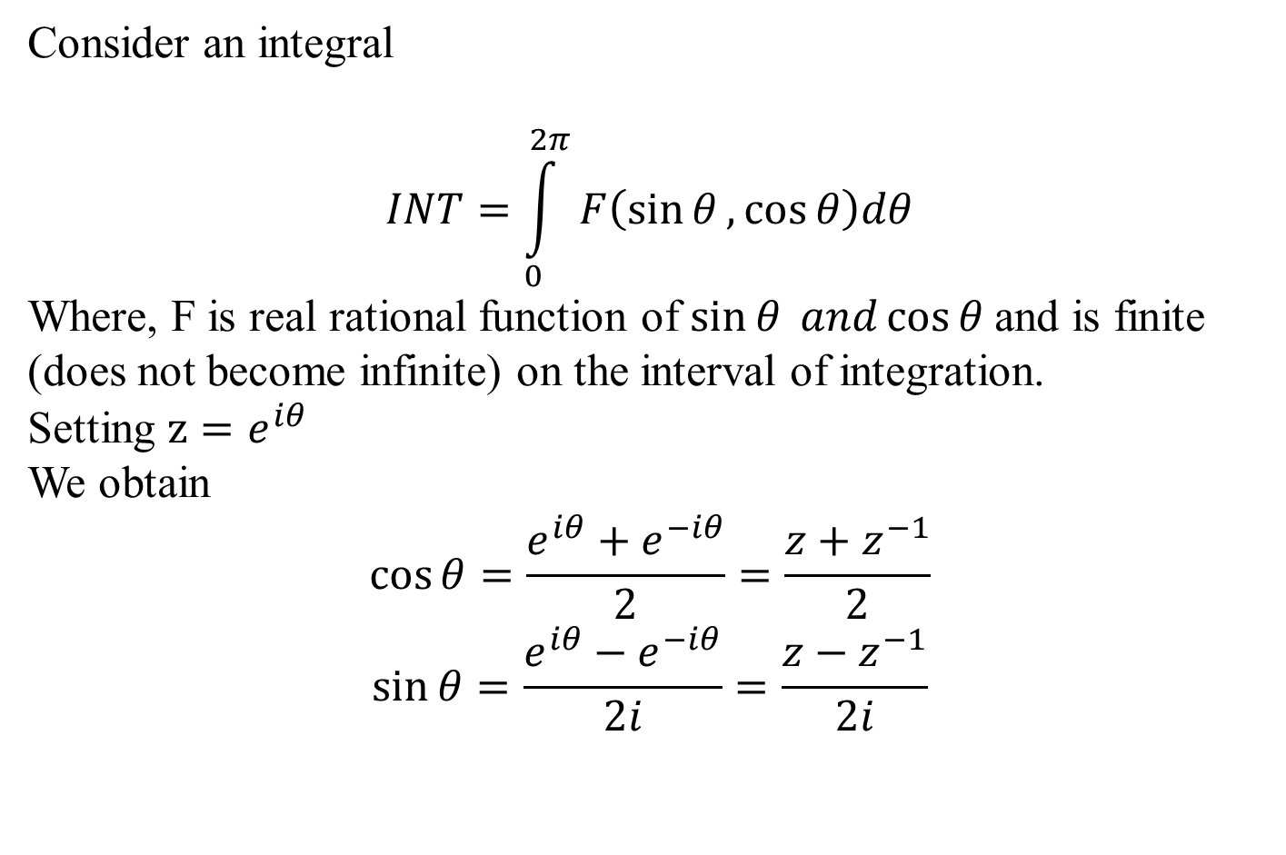
Real definite integrals involving trigonometric functions
Consider an integral
$$INT=\int_{0}^{2π}{F\left(\sin{θ},\cos{θ}\right)dθ}$$
Where, F is real rational function of $\sin{θ} and\cos{θ}$and is finite (does not become infinite) on the interval of integration.
Setting $z=e^{iθ}$
We obtain
$$\cos{θ}=\frac{e^{iθ}+e^{−iθ}}{2}=\frac{z+z^{−1}}{2}$$
$$\sin{θ}=\frac{e^{iθ}−e^{−iθ}}{2i}=\frac{z−z^{−1}}{2i}$$

Slide 4
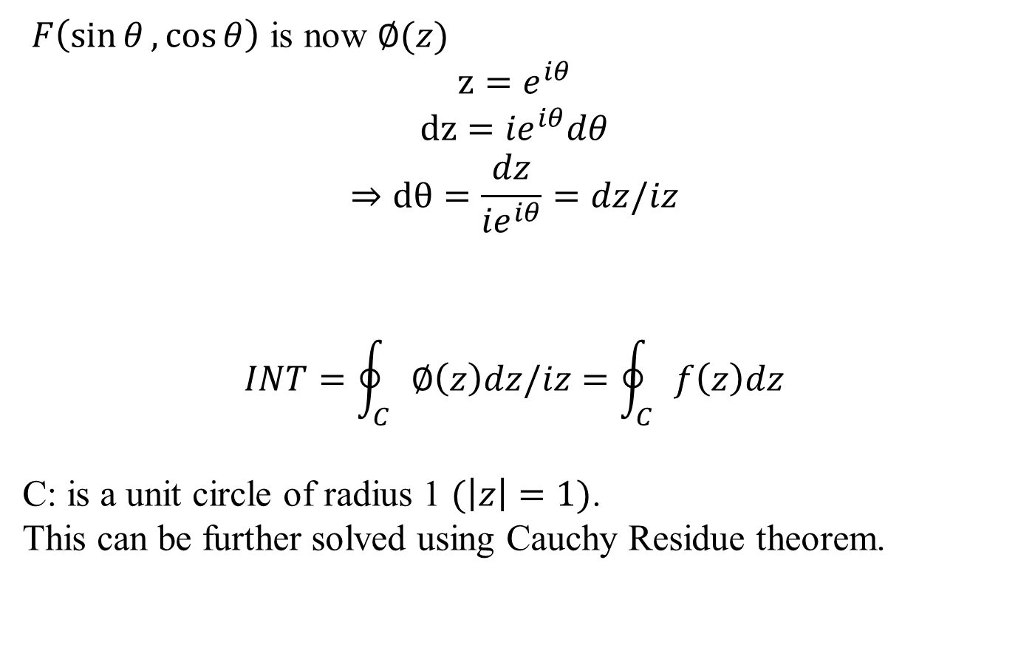
Real definite integrals involving trigonometric functions contd…
$F\left(\sin{θ},\cos{θ}\right)$ is now $∅(z)$
$$z=e^{iθ}$$
$$dz={ie}^{iθ}dθ$$
$$⇒dθ=\frac{dz}{{ie}^{iθ}}=dz/iz$$
$$INT=\oint_{C}{∅\left(z\right)dz/iz}=\oint_{C}{f\left(z\right)dz}$$
C: is a unit circle of radius 1 $(\left|z\right|=1)$.
This can be further solved using Cauchy Residue theorem.

Slide 5

Example 1- Find the value of $\int_{0}^{2π}{\frac{1}{3+\cos{θ}}dθ}$.
Solution-
$$INT=\int_{0}^{2π}{\frac{1}{3+\cos{θ}}dθ}$$
Setting $z=e^{iθ}$
We obtain
$$\cos{θ}=\frac{e^{iθ}+e^{−iθ}}{2}=\frac{z+z^{−1}}{2}$$
$$dz={ie}^{iθ}dθ$$
$$⇒dθ=\frac{dz}{{ie}^{iθ}}=dz/iz$$

Slide 6
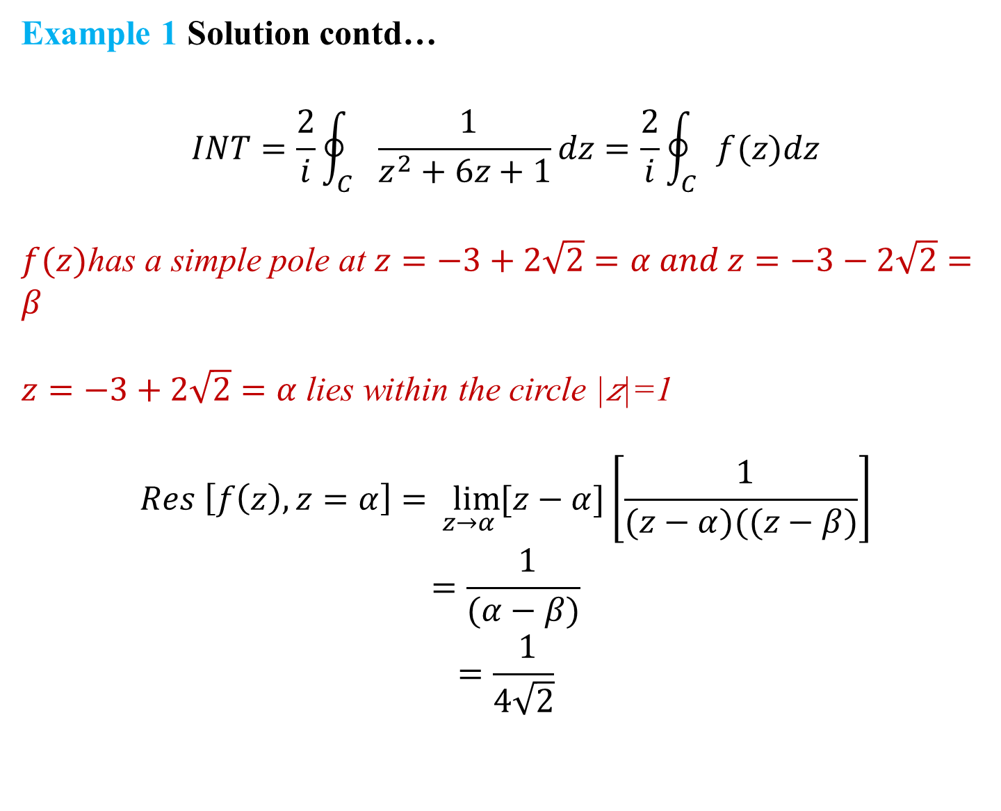
Example 1 Solution contd…
$$INT=\frac{2}{i}\oint_{C}{\frac{ 1}{z^{2}+6z+1}dz}=\frac{2}{i}\oint_{C}{f(z)dz}$$
$f(z)$has a simple pole at $z=−3+2\sqrt{2}=α and z=−3−2\sqrt{2}=β$
$z=−3+2\sqrt{2}=α$lies within the circle |𝑧|=1
$$Res \left[f\left(z\right), z=α\right]=\lim_{z→α}{[z−α]\left[\frac{ 1}{(z−α)((z−β)}\right]}$$
$$=\frac{ 1}{(α−β)}$$
$$=\frac{ 1}{4\sqrt{2}}$$

Slide 7

Example 1 Solution contd…
$$INT=\frac{2}{i}\oint_{C}{\frac{ 1}{z^{2}+6z+1}dz}=\frac{2}{i}\oint_{C}{f(z)dz}=$$
$$=\frac{2}{i}\left(2πiRes \left[f\left(z\right), z=α\right]\right)=\frac{4πi}{4i\sqrt{2}}=\frac{π}{\sqrt{2}}$$
$$⇒\int_{0}^{2π}{\frac{1}{3+\cos{θ}}dθ}=\frac{π}{\sqrt{2}}$$

Slide 8
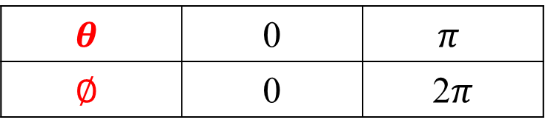

Example 2- Find the value of $\int_{0}^{π}{\frac{1}{1+\sin^{2}θ}dθ}$.
Solution-
$$INT=\int_{0}^{π}{\frac{1}{1+\sin^{2}θ}dθ}=\int_{0}^{π}{\frac{1}{1+\frac{(1−\cos{2θ)}}{2}}dθ}$$
$$=\int_{0}^{π}{\frac{2}{3−\cos{2θ)}}dθ}$$
Let $2θ=∅$
$$dθ=d∅/2$$
$$θ$$ | 0 | $$π$$
$$∅$$ | 0 | 2$π$

Slide 9

Example 2 Solution contd…
$$INT=\int_{0}^{2π}{\frac{d∅}{3−\cos{∅)}}}$$
Setting $z=e^{i∅}$
We obtain
$$\cos{∅}=\frac{e^{i∅}+e^{−i∅}}{2}=\frac{z+z^{−1}}{2}$$
$$dz={ie}^{i∅}d∅$$
$$⇒d∅=\frac{dz}{{ie}^{i∅}}=dz/iz$$
$$INT=−\frac{2}{i}\oint_{C}{\frac{ 1}{z^{2}−6z+1}dz}=−\frac{2}{i}\oint_{C}{f(z)dz}$$

Slide 10
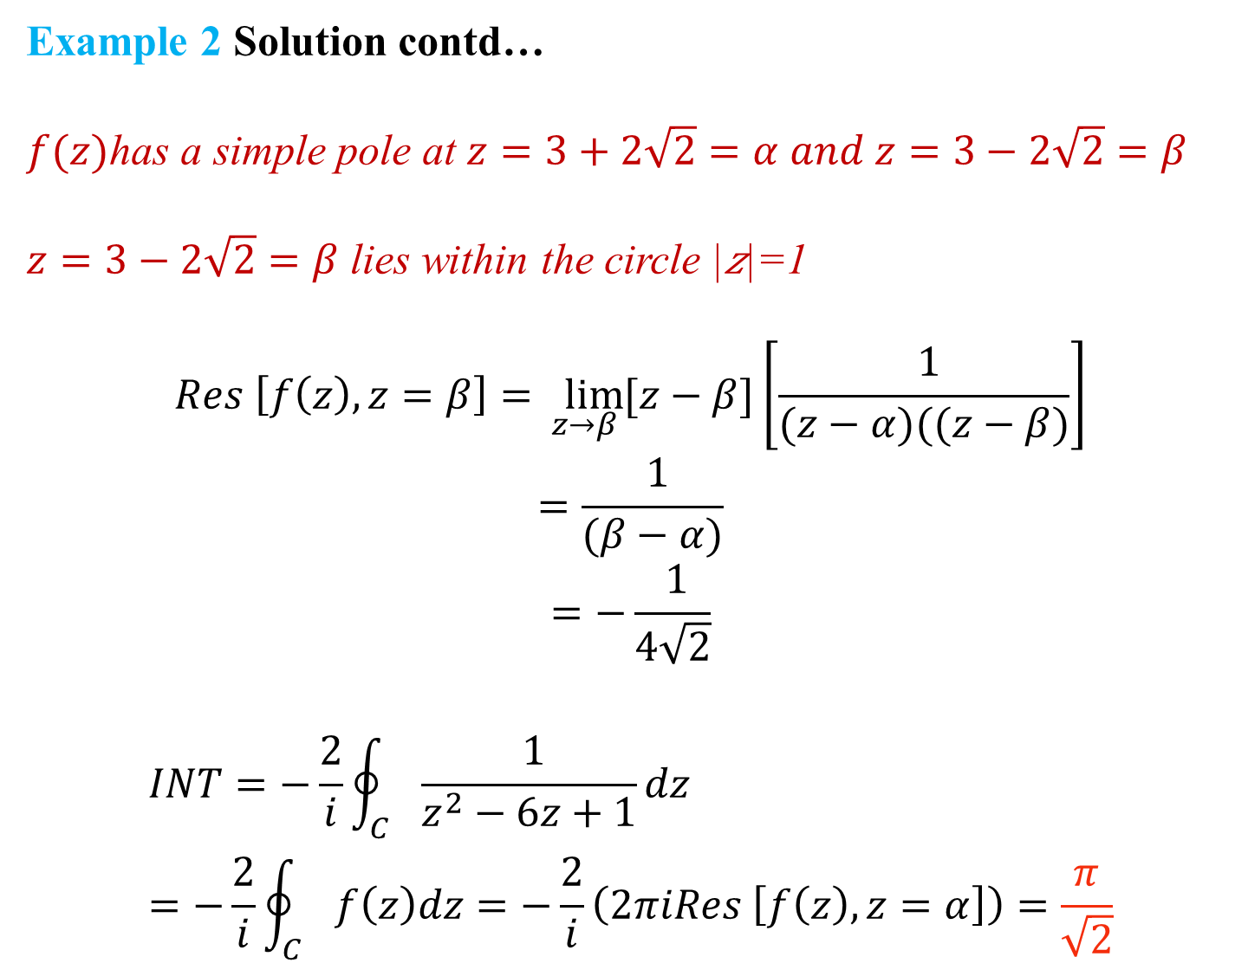
Example 2 Solution contd…
$f(z)$has a simple pole at $z=3+2\sqrt{2}=α and z=3−2\sqrt{2}=β$
$z=3−2\sqrt{2}=β$ lies within the circle |𝑧|=1
$$Res \left[f\left(z\right), z=β\right]=\lim_{z→β}{[z−β]\left[\frac{ 1}{(z−α)((z−β)}\right]}$$
$$=\frac{ 1}{(β−α)}$$
$$=−\frac{ 1}{4\sqrt{2}}$$
$$INT=−\frac{2}{i}\oint_{C}{\frac{ 1}{z^{2}−6z+1}dz}=−\frac{2}{i}\oint_{C}{f\left(z\right)dz=−\frac{2}{i}\left(2πiRes \left[f\left(z\right), z=α\right]\right)=\frac{π}{\sqrt{2}}}$$

Slide 11

Example 3- Evaluate $\int_{0}^{2π}{\frac{\cos{2θ}}{5−4cos{θ}}dθ}$.
Solution-
$$INT=\int_{0}^{2π}{\frac{\cos{2θ}}{5−4cos{θ}}dθ}=Real Part of\int_{0}^{2π}{\frac{e^{2iθ}}{5−4cos{θ}}dθ}$$
Setting $z=e^{iθ}$
$$e^{2iθ}=z^{2}$$
We obtain
$$\cos{θ}=\frac{e^{iθ}+e^{−iθ}}{2}=\frac{z+z^{−1}}{2}$$
$$dz={ie}^{iθ}dθ$$
$$⇒dθ=\frac{dz}{{ie}^{iθ}}=dz/iz$$

Slide 12
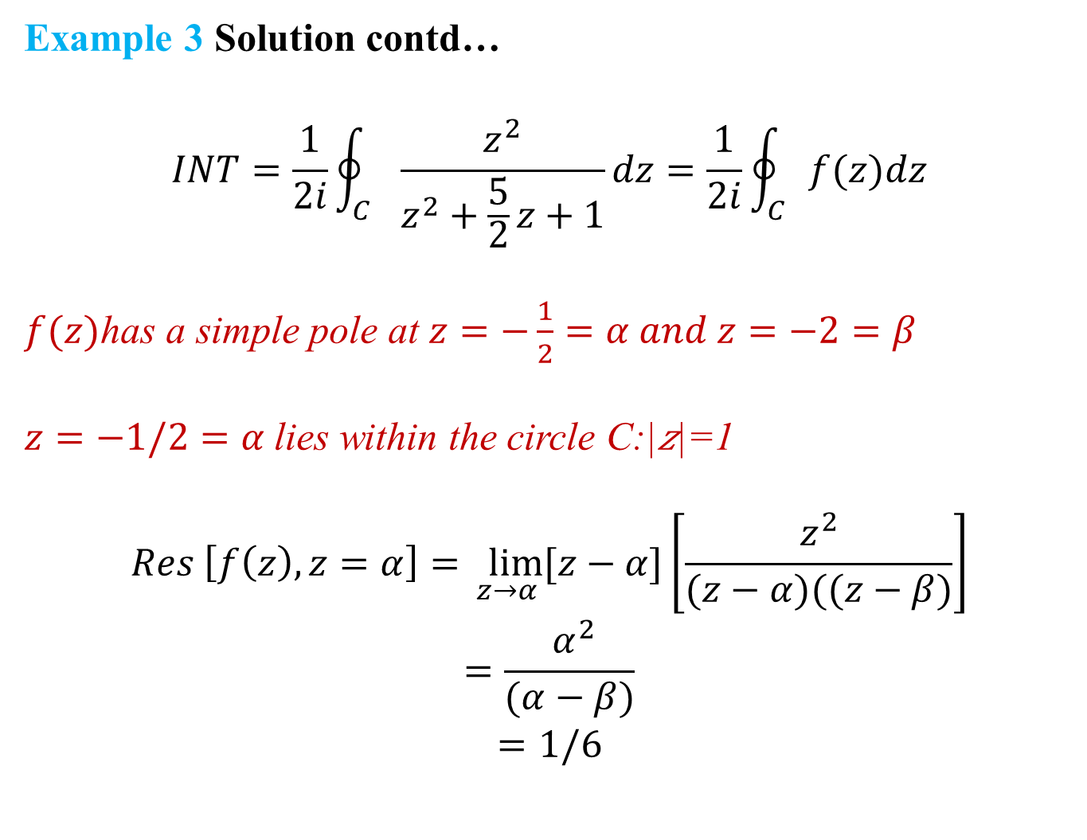
Example 3 Solution contd…
$$INT=\frac{1}{2i}\oint_{C}{\frac{z^{2}}{z^{2}+\frac{5}{2}z+1}dz}=\frac{1}{2i}\oint_{C}{f(z)dz}$$
$f(z)$has a simple pole at $z=−\frac{1}{2}=α and z=−2=β$
$z=−1/2=α$lies within the circle C:|𝑧|=1
$$Res \left[f\left(z\right), z=α\right]=\lim_{z→α}{[z−α]\left[\frac{z^{2}}{(z−α)((z−β)}\right]}$$
$$=\frac{ α^{2}}{(α−β)}$$
$$=1/6$$

Slide 13
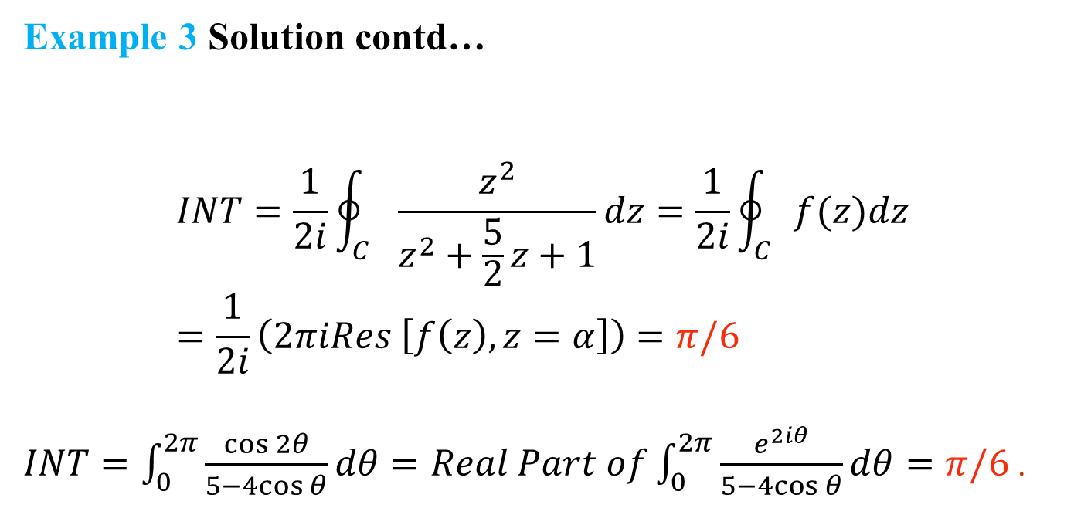
Example 3 Solution contd…
$$INT=\frac{1}{2i}\oint_{C}{\frac{z^{2}}{z^{2}+\frac{5}{2}z+1}dz}=\frac{1}{2i}\oint_{C}{f(z)dz}=\frac{1}{2i}\left(2πiRes \left[f\left(z\right), z=α\right]\right)=π/6$$
$INT=\int_{0}^{2π}{\frac{\cos{2θ}}{5−4cos{θ}}dθ}=Real Part of\int_{0}^{2π}{\frac{e^{2iθ}}{5−4cos{θ}}dθ}=π/6$ .

Slide 14
Thank You

